Slide 1
Supermarket-chain sales analysis
US Tariff Impact and Rectification Analysis
By Yog Gupta

Slide 2
Summary
This presentation shows how newly imposed U.S. tariffs could affect Indian export categories and how much of the loss can be absorbed or recovered using policy, operational and demand‑side levers. The workflow combines time‑series regression (XGBoost/XGBRegressor) with an economics layer (elasticity + pass‑through) and quantified levers (rebates, cost savings, loyalty/bundling, etc.).

Slide 3
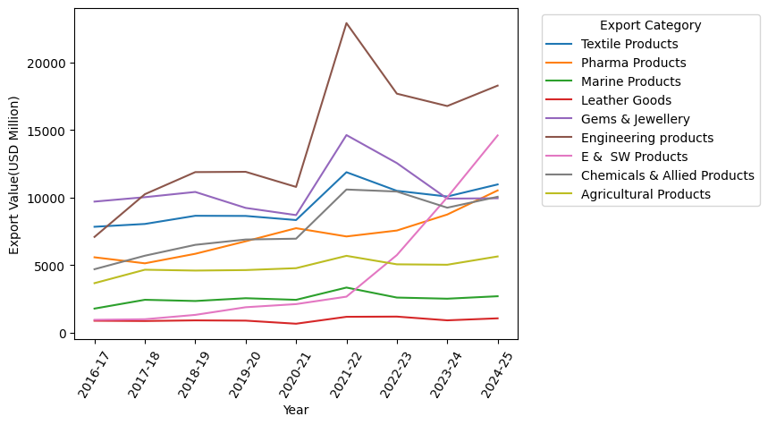
Yearly exports by category
The India’s yearly exports to US are categorised in 9 categories as shown here.
In the year 2021-22, an outlier was observed in some sectors. Probably due to market opening after the COVID 1st wave. The trade values for each sector in 2021-22 were replaced with average of previous 3 years data of respective sectors.

Slide 4
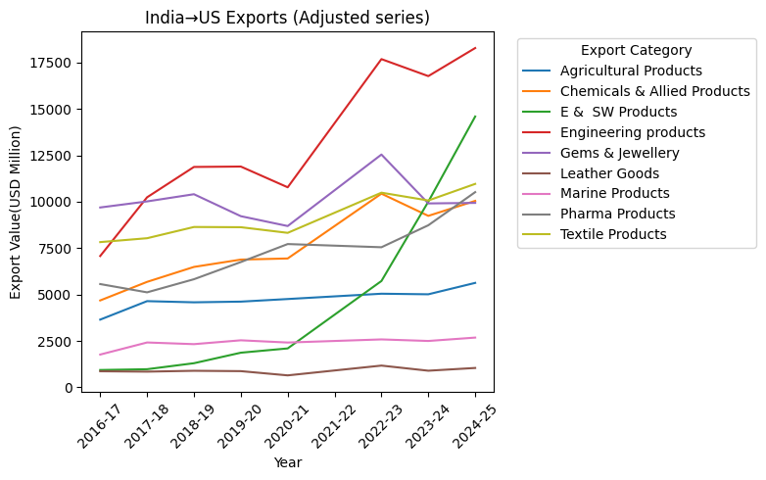
Cleaned data
(Data after the outlier removal)
The outlier removal resulted in some clear insights, like the rapid surge of demands in a few sectors while others nearly flatlined.

Slide 5
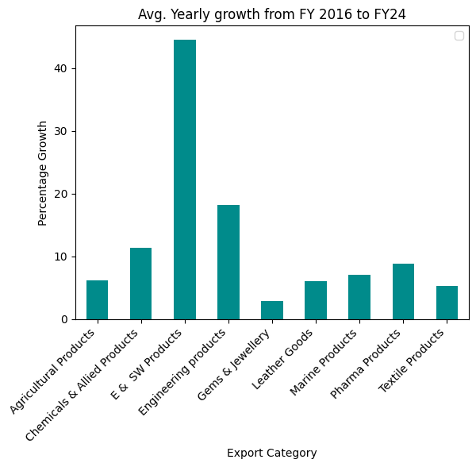
The average sectoral growth per year
The average growth rate from FY 2016 to FY 2024 could exceed to more than 40%.
The E&SW sector comprising Electronics goods shows maximum growth followed by Engineering products and Chemicals.

Slide 6
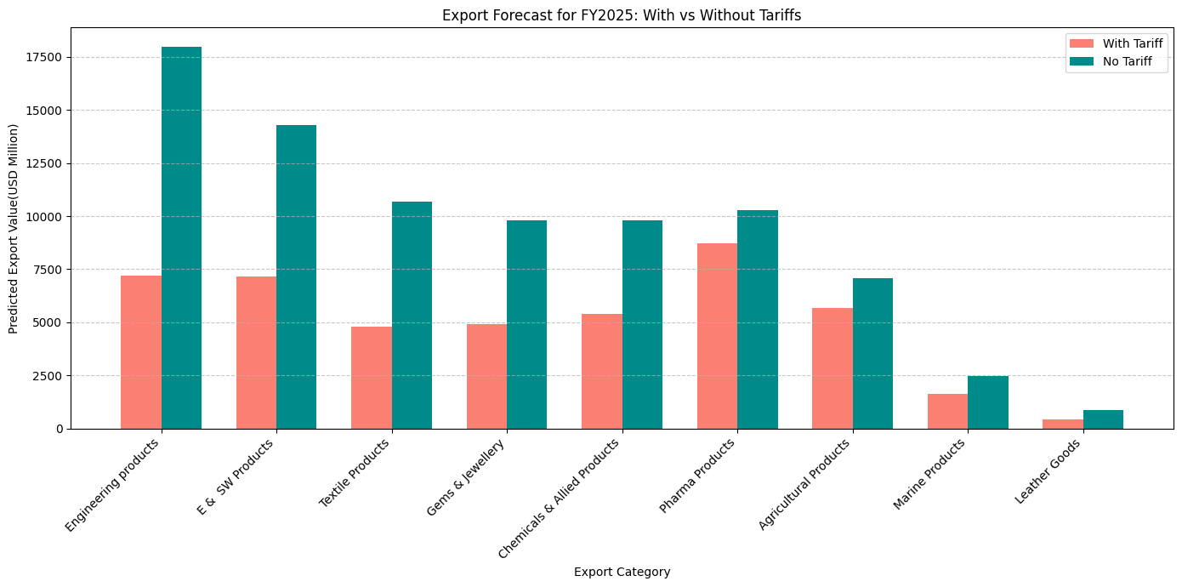
Exports comparison for FY 2025
(Predicted using XGBoost. Based on elasticity of each sector)

Slide 7
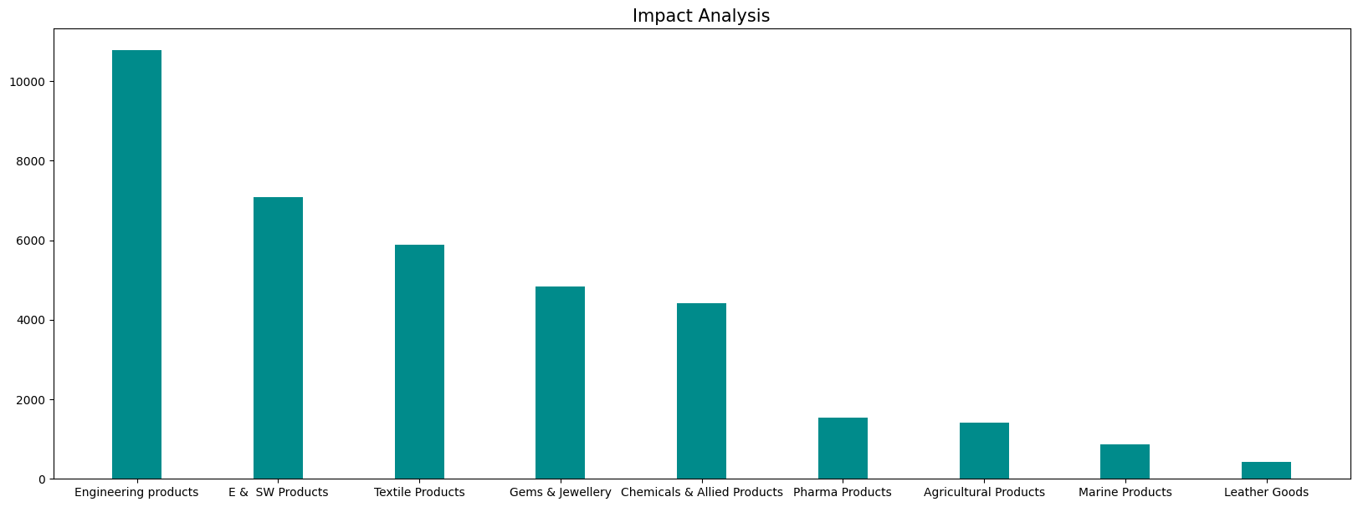
Estimated Impact on each sector
Total losses are estimated to go up to $37238 Million USD.
Most affected:
Engineering sector | $10780 Million USD
E & SW Products | $ 7077 Million USD
Textiles | $ 5886 Million USD

Slide 8
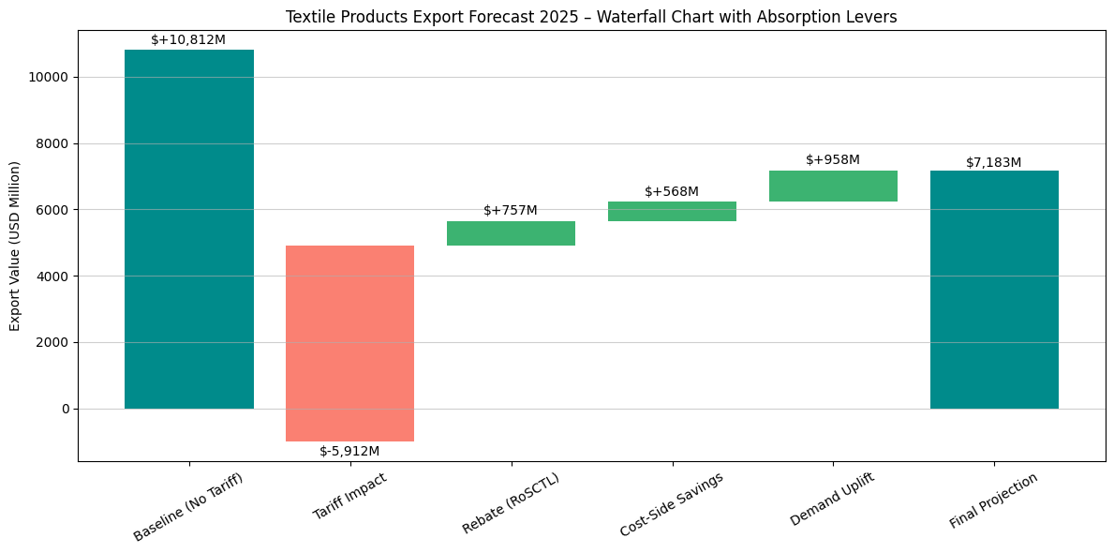
Loss Recovery
Tariff impact before absorption levers: | Forecast post applying absorption levers:
Baseline FY 2025 (no tariff): $10,812M | Loss avoided (“business saved”) vs tariff‑only: $2,283M
Tariff‑only projection: $4,900M | % of tariff loss recovered: 38.6%
Loss without levers: $5,912M (−54.7% vs baseline | Final vs baseline: −33.6% (i.e., at 66.4% of baseline)

Slide 9
Thank You

